Slide 1
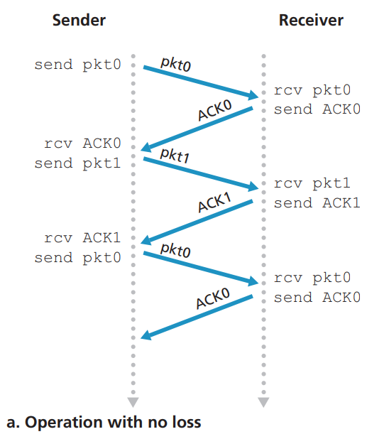
rdt3.0: Operation with no loss

Slide 2
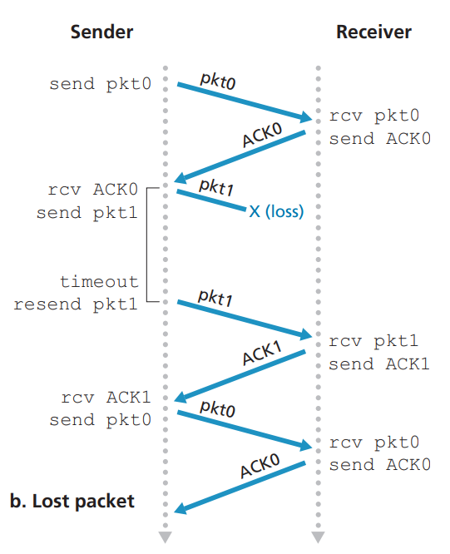
rdt3.0: Packet Loss

Slide 3
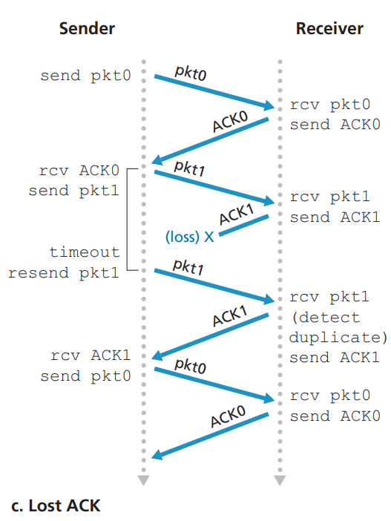
rdt3.0: ACK Lost

Slide 4
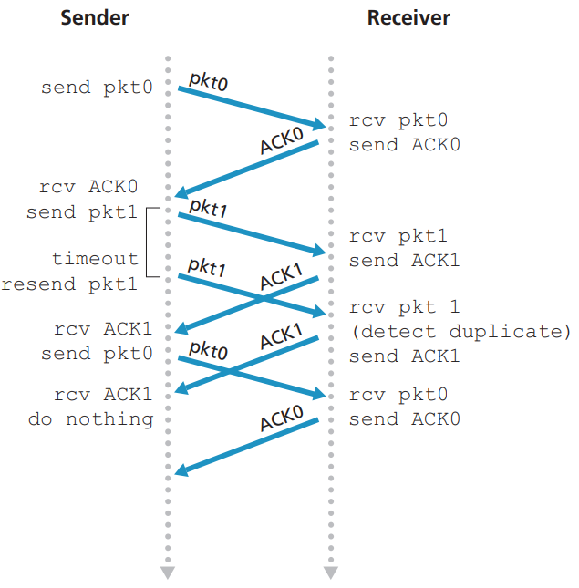
rdt3.0: Premature Timeout

